Slide 1
To Kill a Mockingbird Notes
Ms. Ellsworth 2014

Slide 2
Ch 1- Notes
Scout (Jean Louise Finch)- female narrator
Jem- her older brother
Dill- their friend
Atticus- their father
Calpurnia- their African American cook/servant
Arthur “Boo” Radley- Their neighbor
Stephanie Crawford- gossiping neighbor
Maycomb County- where they live

Slide 3
The Radley’s
Mr. and Mrs. Radley and two sons lived across the street for “as long as [Scout] could remember”
“shut up their doors on Sundays”
Boo ran with the wrong crowd and was locked in his home by his father instead of going to training school
Stabbed his father w/ scissors at age 33

Slide 4
The Radley’s (cont)
“From the day that Mr. Radley took Arthur home [from the courthouse cellar- where he was being kept for stabbing his dad], people said the house died” (ch 1).
After Mr. Radley’s death, Nathan Radley (Boo’s older brother) moved back into home
Kids tried to make Boo “come out”

Slide 5
Ch 2 Notes- Scout goes to school
Scout gets in trouble almost immediately b/c she knows how to read- teacher tells her NOT to let her dad teach her anymore
Walter Cunningham- poor boy- too proud to pay back Ms. Caroline
Scout tries to explain, but Ms. Caroline hits her hand with a ruler as punishment
This makes her hate school

Slide 6
Ch 3 Notes
Scout beats up Walter at recess b/c she is mad that she got in trouble
Jem invites Walter for dinner
Scout disgusted by fact that Walter pours syrup all over his dinner- Calpurnia scolds her
Scout returns to school next day- Ms. Caroline disgusted by “cootie” in Burris Ewell’s hair
He can’t read or spell- only comes to school one day a year
Mean- swore at Ms. Caroline (he’s in first grade!!!)

Slide 7
Ch 3 Notes- Atticus’s Advice
“First of all,” he said, “if you can learn a simple trick, Scout, you’ll get along a lot better with all kinds of folks. You never really understand a person until you consider things from his point of view…until you climb into his skin and walk around it.”
Scout learns that the Ewells have their own set of rules in Maycomb County

Slide 8
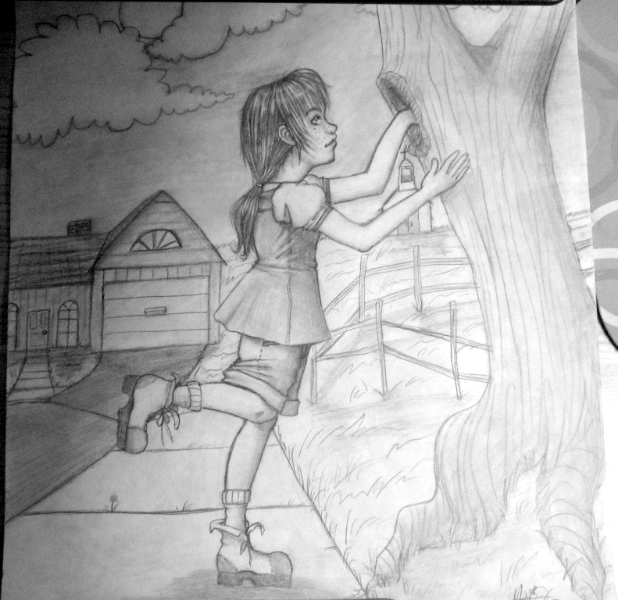
Ch 4- Notes
Scout finds a present in a tree in front of Boo Radley’s house
Then, Jem and Scout find pennies in the tree
Dill, Scout and Jem spent the whole summer pretending to be the Radley family
They had to quit the game because Atticus didn’t want them playing with scissors.
Scout said she wanted to quit the game because she had heard someone laughing inside the Radley house on the day that she rolled into the yard…

Slide 9
Ch 5-19 Notes
A black man, Tom Robinson, is accused of raping Bob Ewell’s daughter, Mayella. Attitus decides to represent Tom Robinson and be his lawyer.
Other Important characters:
Heck Tate- sherrif
Tom Robinson- black man accused of rape, has a bum left hand
Mayella- Bob Ewell’s daughter
Mr. Glimmer- the prosecutor (opposing attorney- supposed to prove Tom Robinson to be guilty)
Ch 19- Trial is happening- Tom Robinson is put on the stand
Atticus questions him- what logical argument does he make about Tom NOT being ABLE to rape Mayella?

Slide 10
Ch 19 & 20- Notes (cont)
Dill cries at end of chapter b/c he’s bothered by how Mr. Glimmer treated Tom on the stand
Do you believe Mayella?
Scout says, “[Atticus] is the same in the courtroom as he is on the public streets” (199). What kind of guy is he?
Ch 20- Atticus’s Closing Argument
Mayella “tempted a Negro”
Suggests that someone ELSE beat her instead- WHO?
He says, “In the name of God, do your duty” to the jury. Meaning what?

Slide 11
Ch 21-26 Notes
What was the verdict of the trial?
What did all of the African Americans do to show their respect when Atticus left the court room?
Jem cried about the verdict- he thought for sure that Tom would have been found innocent
During the Great Depression, lots of food was hard to come by- how did the African American community show their appreciation of Atticus?
At the end of chapter 26, Atticus tells Scout that Jem “was trying hard to forget something…” What is he referencing?

Slide 12
Ch 28-End Notes
Scout was in school play- dressed like a ham (costume made out of chicken wire)
On way home, Jem and Scout were attacked by Bob Ewell. Jem was badly hurt.
Boo Radley saved them- Scout would have been stabbed if it wasn’t for her costume
Jem stabbed and killed Bob Ewell, but Heck Tate (sherrif) said that he “fell on his own knife”
Why was Atticus against this claim?
Why does Scout say “It would be like killing a mockingbird”?

