Slide 1
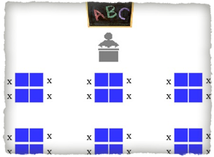
Welcome
Please find your name and sit with like colors.
Materials Needed
Pen or pencil
Textbook
Today’s Handout
Name Card

Slide 2
Please respond to the following prompt in your journals.
What does this quote mean to you?
“Follow Your Heart.”

Slide 3
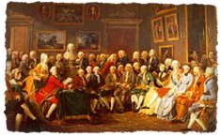
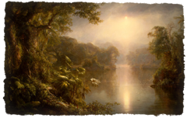
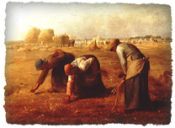
________________?
Romanticism
Dark Romanticism
Transcendentalism
Realism
Naturalism

Slide 4
The Enlightenment!
Romanticism
Dark Romanticism
Transcendentalism
Realism
Naturalism

Slide 5
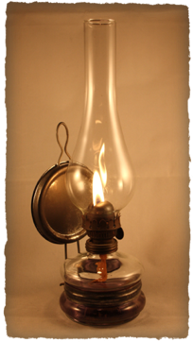
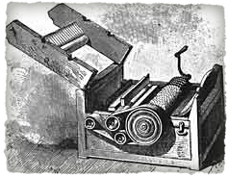
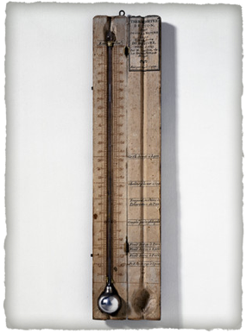
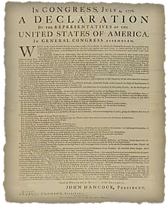
The Enlightenment

Slide 6
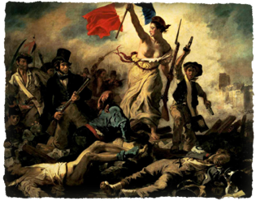
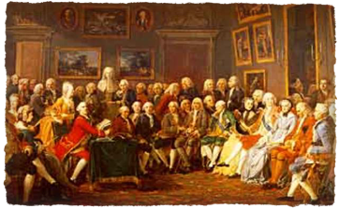
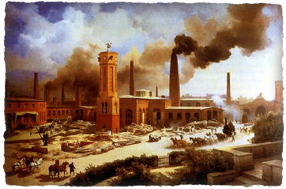
What’s happening prior to the 1800’s?

Slide 7
What’s happening prior to the 1800’s?
French Revolution (1789 - 1799)
American Revolution (1775 - 1783)
Industrial Revolution (1760 - 1850)

Slide 8
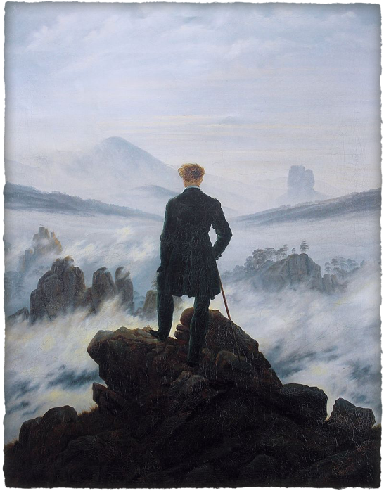
Practice!
What Romantic characteristics do you see in this painting?
Time Pair Share!
Wanderer above the Sea of Fog by Caspar David Friedrich 1818

