Slide 1
“[The blade] shot forward, and a human body, this citadel of virtue, wisdom, power, was pierced as easily as if it had been a melon.”
from Stephen Crane’s “The Blue Hotel”

Slide 2
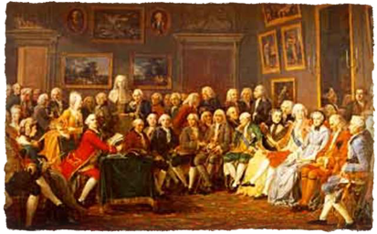
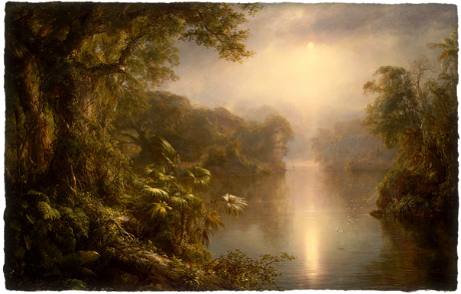
The Enlightenment
Reason, Logic, Science
Romanticism
Dark Romanticism
Transcendentalism
Feeling, Intuition, Nature

Slide 3
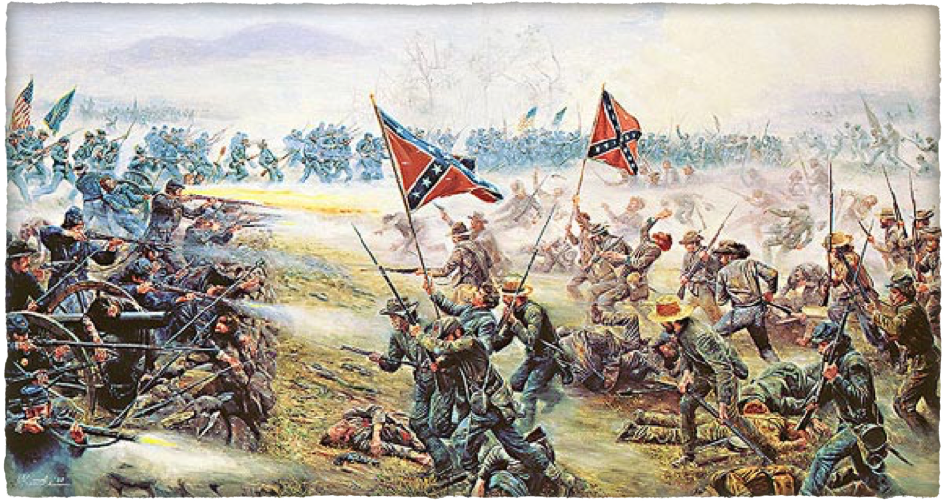
Civil War 1861 -1865

Slide 4
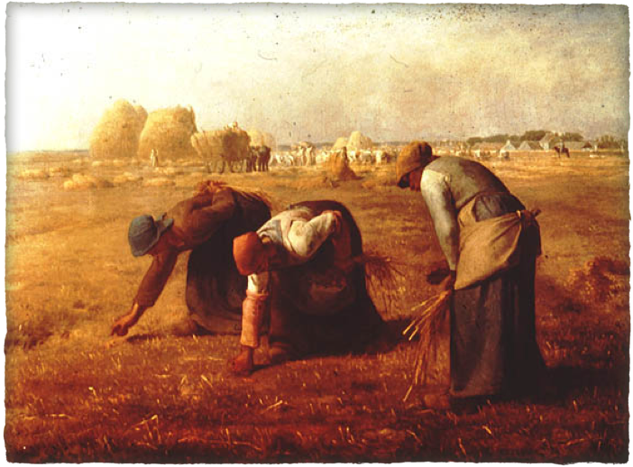
Realism
Regionalism
Naturalism

Slide 5
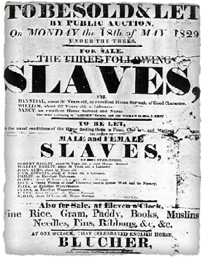
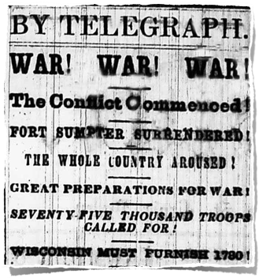
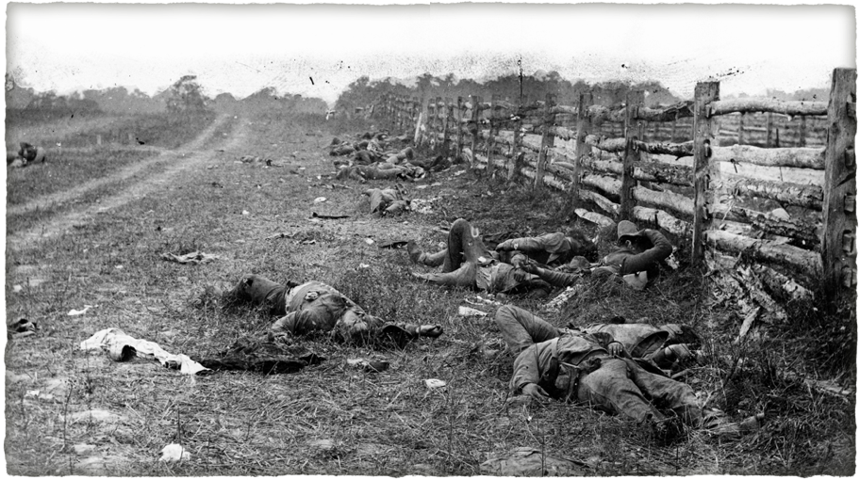
What’s happening during the Civil War?

Slide 6
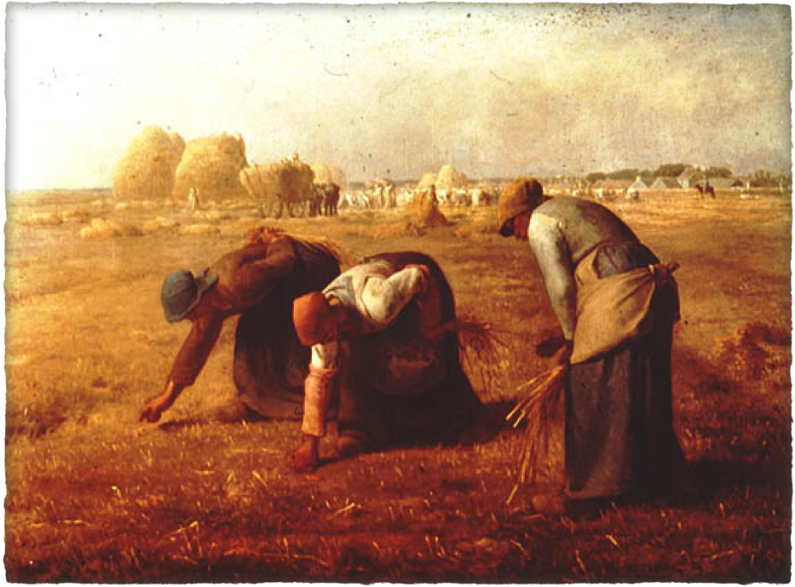
Jean-Francois Millet,"The Gleaners," 1857

