Slide 1
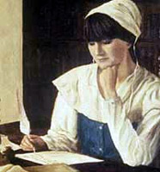
The Puritan Tradition & Anne Bradstreet (1612-1672)

Slide 2
Who were the Puritans?
Who Were the Puritans?

Slide 3
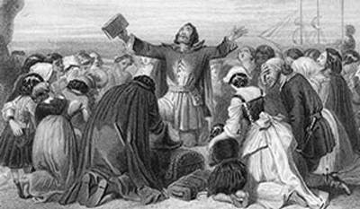
Puritan Beliefs
Human beings are inherently evil and must struggle to overcome their sinful nature.
Personal salvation depends solely on the grace of God.
The Bible is the supreme authority on earth.

Slide 4
Puritan Logic
The longer you live, the more opportunity you have to sin.
The more you sin, the angrier God becomes.
The angrier He becomes, the worse your eternal punishment will be.
The sooner you die, the better off you will be in the afterlife.

Slide 5
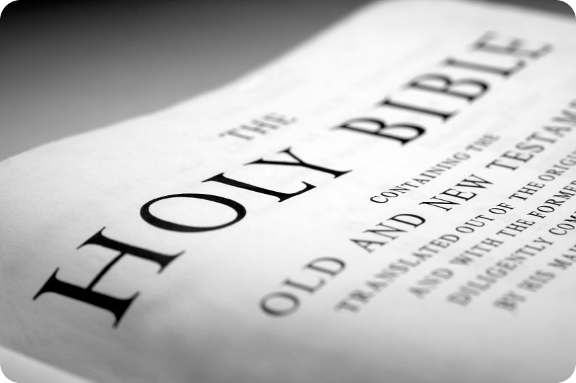
Puritan Literature
Its purpose is for moral instruction only.
Types of literature include sermons, poetry, and hymns
It also discusses the love and care of husbands and their children by their wives.

Slide 6
Anne Bradstreet: Early Life
Born Anne Dudley in Northampton, England in 1612.
Father managed Earl of Lincoln’s estate.
Provided daughter with excellent educational opportunities during her early years.
At age 16, married Simon Bradstreet.
Year after their marriage, he was appointed to assist with preparations for Massachusetts Bay Company.
In 1630, the Bradstreet’s father (and her father) boarded John Winthrop’s flagship Arabella to begin the Puritans’ journey to the colonies.
Notes:
She lived in a time when the amount of education that a woman received was little to none. Even though she did not attend school, she was privileged enough to receive her education from eight tutors and from her father, Thomas Dudley, who was always more than willing to teach her something new. She was a very inquisitive young person who satisfied her hunger for knowledge through her extensive reading of some of the greatest authors ever known. Thanks to her father's position as the steward of the Earl of Lincoln estate, she had unlimited access to the great library of the manor. This is where she became exposed to the writings of many well known authors. In 1628 she married Simon Bradstreet, her father's assistant.
Father and husband were both governers of Mass in their lifetimes.

Slide 7
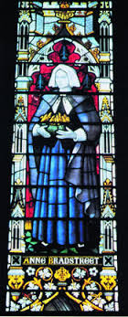
Puritan Influences
Because of the tendency of the Puritans to ostracize female intellectuals, Anne was very hesitant to publish any of her poetry.
Though the men in her life had social prominence, “Any woman who sought to use her wit, charm, or intelligence in the community at large found herself ridiculed, banished, or executed by the Colony's powerful group of male leaders” (Woodlief).

Slide 8
Bradstreet’s Poetry
Considered by many to be the first American poet.
Poetry reflects trials about her new circumstances in New World.
Religious, historical, and domestic themes.
Also reflects mixture of intellect, strength, and a woman comfortable with her lower position in Puritan society.
Some of her final poems expressed her belief in the worth and ability of women, a topic that was very controversial in her culture.
Sometimes questions truth & spiritual matters accepted by her religious sect.
Her poetry does not reflect the avenging God of the Puritans
Notes:
Was taken from her home of luxury and put down in a wilderness – had imposed upon her a terrible adjustment.
No wonder she questioned the wisdom of the puritans removal to American and even the beliefs that motivated it.
Endured bad health during the first few years of residence in the colony.

Slide 9
References
RPO Editors, Department of English, and UTO. Representative Poetry Online. 05 Oct. 2004 http://eir.library.utoronto.ca/rpo/display/poem208.htm
Ann Woodlief. Anne Bradstreet. 05 Oct. 2004 http://www.vcu.edu/engweb/eng384/bradbio.htm
Ann Woodlief. Study Texts on Anne Bradstreet’s Poetry 05 Oct. 2004 http://www.vcu.edu/engweb/webtexts/
Bradstreet/bradread.htm

